Slide 1


SCST1223
Probability & statistical data analysis
CHAPTER 7
PART 1
CORRELATION ANALYSIS
Innovating Sustainable Solutions

Slide 2
What is Correlation?
The word Correlation is made of Co- (meaning "together"), and Relation, and it can be defined as :
  a measure of the statistical relationship between two comparable variables or quantities(bivariate data).
When two sets of data are strongly linked together we say they have a High Correlation
Correlation is Positive when the values increase together, and
Correlation is Negative when one value decreases as the other increases
No correlation – the value does not tend to either increase or decrease as the other increases .

Slide 3
Scatter Plots
A scatter plot (or scatter diagram) is used to show the relationship between two variables
One variable is on the X-axis, one on the Y-axis
The pattern of data is indicative of the type of relationship between two variables:
  positive relationship
  negative relationship
  no relationship
  curvilinear relationship

Slide 4
Scatter Plot Examples
Linear relationships
Curvilinear relationships
y
y
x
x
y
y
x
x

Slide 5
Scatter Plot Examples
(continued)
Strong relationships
Weak relationships
y
y
x
x
y
y
x
x

Slide 6
Scatter Plot Examples
(continued)
No relationship
y
x
y
x

Slide 7
Correlation Analysis
Correlation analysis is used to measure strength of the association (linear relationship) between two variables
  Only concerned with strength of the relationship
  No causal effect is implied

Slide 8
Correlation Coefficient
A correlation coefficient is a numerical assessment of the strength of relationship between the x and y values in a set of (x,y) pairs.
The population correlation coefficient ρ (rho) measures the strength of the association between the variables.
The sample correlation coefficient r is an estimate of ρ and is used to measure the strength of the linear relationship in the sample observations.

Slide 9
Properties of r
The value of r does not depend on the unit of measurement for either variable.
The value of r does not depend on which of the two variable is considered x.
The value of r is between -1 and 1.

Slide 10
Properties of r
The value of r is a measure of the extent to which x and y are linearly related.
Number represents the strength of the relationship
Sign (+ or -) represents the direction of the relationship (positive or negative)
  Positive values denote positive linear correlation
  Negative values denote negative linear correlation
  A value of 0 denotes no linear correlation
Example: correlation of -0.87 is considered stronger than correlation of 0.56

Slide 11
Properties of r
The correlation coefficient r = 1 only when all the points in a scatterplot of the data lie exactly on a straight line that slopes upward. (Perfect positive correlation)
Similarly, r = -1 only when all the points lie exactly on a downward-sloping line. (Perfect negative correlation)
Coefficient usually not “perfect”

Slide 12
Properties of r
The closer to -1, the stronger the negative linear relationship.
The closer to 1, the stronger the positive linear relationship.
The closer to 0, the weaker the linear relationship.

Slide 13
Properties of r
Measure the strength of a linear relationship.
strong
moderate
weak
moderate
strong
-1
-0.8
-0.5
0
0.5
0.8
1

Slide 14
Examples of Approximate r Values
y
y
y
x
x
x
r = -1
r = -0.6
r = 0

Slide 15
Examples of Approximate r Values
y
y
x
x
r = +0.3
r = +1

Slide 16
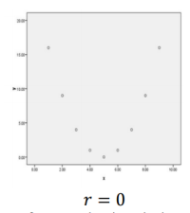
No correlation
The correlation coefficient is a measure of linear relationship and thus look at the scatterplot of the data before concluding that there is no relationship between two variables when r is close to 0.
There could be a curvilinear relationship. For example in the following scatterplot which implies no (linear) correlation however there is a perfect quadratic relationship.

Slide 17
Positive Correlation
Relationship shows that a high score on one variable is related to a high score on another variable
OR
A low score on one variable is related to a low score on another variable
Correlation coefficient is greater than 0

Slide 18
Positive Correlation
What is the relationship between the number of hours spent per week studying and GPA?
r = 0.884
Students | Study Hours | GPA
S1 S2 S3 S4 S5 S6 S7 S8 | 42 23 31 35 16 26 39 19 | 3.3 2.9 3.2 3.2 1.9 2.4 3.7 2.5
It can be seen that the GPA increases as the hours increases. A scatter plot and correlation analysis of the data indicates that there is positive relationship between the number of hours spent per week studying and GPA.

Slide 19
Negative Correlation
Relationship shows that a high score on one variable is related to a low score on the second variable
Correlation coefficient is less than 0

Slide 20
Negative Correlation
What is the relationship between the number of hours spent per week watching TV and GPA?
r = -0.892
Students | TV | GPA
S1 S2 S3 S4 S5 S6 S7 S8 | 42 23 31 35 16 26 39 19 | 1.8 3.0 2.2 2.9 3.7 3.0 2.4 3.4
It can be seen that the GPA decreases as the hours increases. A scatter plot and correlation analysis of the data indicates that there is negative relationship between the number of hours spent per week watching TV and GPA.

Slide 21
Exercise #1
The data represent x = score on a measure of test anxiety and y = exam score for a sample of n = 9 students:
Higher values for x indicate higher levels of anxiety.
x | 23 | 14 | 14 | 0 | 17 | 20 | 20 | 15 | 21
y | 43 | 59 | 48 | 77 | 50 | 52 | 46 | 51 | 51

Slide 22
Exercise 1 (cont.)
Construct a scatter plot, and comment on the features of the plot.
Does there appear to be a linear relationship between the two variables? How would you characterize the relationship?

Slide 23
SCST1223
Probability & statistical data analysis
CHAPTER 7
PART 1
CORRELATION ANALYSIS (2)
PEARSON CORRELATION
Innovating Sustainable Solutions

Slide 24
Correlation Types
The two most popular correlation coefficients are:
  Pearson's product-moment correlation coefficient.
  Spearman's rho rank correlation coefficient
When calculating a correlation coefficient for ordinal data, select Spearman's rho technique.
For interval or ratio-type data, use Pearson's technique.

Slide 25
Pearson's Product-Moment Correlation Coefficient
Sample correlation coefficient:
where:
r = Sample correlation coefficient
n = Sample size
x = Value of the independent variable
y = Value of the dependent variable

Slide 26
Pearson's Product-Moment Correlation Coefficient
Assumes normality in both variables (bivariate normally distributed).
There needs to be a linear relationship between the two variables.
Two variables should be measured at the interval or ratio level.
It is sensitive to outliers (can have a very large effect on the line of best fit and the Pearson correlation coefficient, leading to very difficult conclusions regarding the data)

Slide 27
Example
Tree Height | Trunk Diameter
y | x | xy | y² | x²
35 | 8 | 280 | 1225 | 64
49 | 9 | 441 | 2401 | 81
27 | 7 | 189 | 729 | 49
33 | 6 | 198 | 1089 | 36
60 | 13 | 780 | 3600 | 169
21 | 7 | 147 | 441 | 49
45 | 11 | 495 | 2025 | 121
51 | 12 | 612 | 2601 | 144
Σ=321 | Σ=73 | Σ=3142 | Σ=14111 | Σ=713

Slide 28
Example
(continued)
Tree
Height,
y
r = 0.886 → relatively strong positive
linear association between x and y
Trunk Diameter, x

Slide 29
Exercise #2
The data represent x = score on a measure of test anxiety and y = exam score for a sample of n = 9 students:
Higher values for x indicate higher levels of anxiety.
x | 23 | 14 | 14 | 0 | 17 | 20 | 20 | 15 | 21
y | 43 | 59 | 48 | 77 | 50 | 52 | 46 | 51 | 51

Slide 30
Exercise #2 (cont.)
Construct a scatter plot, and comment on the features of the plot.
Does there appear to be a linear relationship between the two variables? How would you characterize the relationship?
Compute the value of the correlation coefficient. Is the value of r consistent with your answer to part (b)?
Is it reasonable to conclude that test anxiety caused poor exam performance? Explain.

Slide 31
Spearman's Rho Rank Correlation Coefficient
Denote by r_{s} for sample data (with r used to denote that it is a correlation coefficient, and the subscript s to denote that it is named after the statistician Spearman.)
The linear correlation coefficient between the ranks of data on variable x and y
where
d_{i} = y_{i} – x_{i} (difference in ranks)
n = sample size

Slide 32
SCST1223
Probability & statistical data analysis
CHAPTER 7
PART 1
CORRELATION ANALYSIS (3)
SPEARMAN CORRELATION
Innovating Sustainable Solutions

Slide 33
Spearman's Rho Rank Correlation Coefficient
It is less sensitive to bias due to outliers
It is applied to ordinal variables.

Slide 34
Example
As an example, let us consider a musical (solo vocal) talent contest where 10 competitors are evaluated by two judges, A and B.
Usually judges award numerical scores for each contestant after his/her performance.
Spearman Rho Rank Correlation Coefficient can indicate if judges agree to each other’s views as far as talent of the contestants are concerned (though they might award different numerical scores) – in other words if the judges are unanimous.

Slide 35
Example
In order to compute Spearman Rank Correlation Coefficient, it is necessary that the data be ranked.
There are a few issues here.
Suppose that scores of the judges (out of 10 were as follows):
Contestant No. | 1 | 2 | 3 | 4 | 5 | 6 | 7 | 8 | 9 | 10
Score by Judge A | 5 | 9 | 3 | 8 | 6 | 7 | 4 | 8 | 4 | 6
Score by Judge B | 7 | 8 | 6 | 7 | 8 | 5 | 10 | 6 | 5 | 8

Slide 36
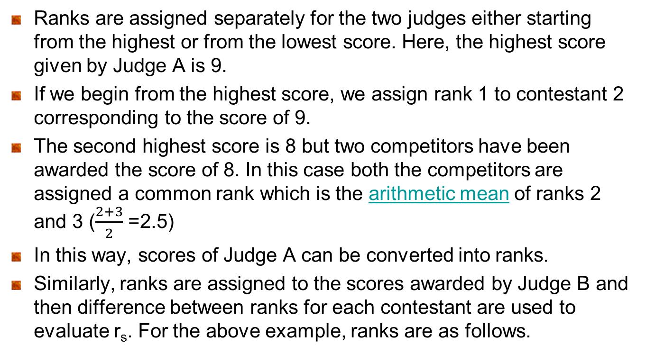
Example

Slide 37
Example
For this example, ranks are as follows.
Contestant No. | 1 | 2 | 3 | 4 | 5 | 6 | 7 | 8 | 9 | 10
Ranks of scores by Judge A | 7 | 1 | 10 | 2.5 | 5.5 | 4 | 8.5 | 2.5 | 8.5 | 5.5
Ranks of scores by Judge B | 5.5 | 3 | 7.5 | 5.5 | 3 | 9.5 | 1 | 7.5 | 9.5 | 3

Slide 38
Example
Contestant No. | Ranks of scores by Judge A | Ranks of scores by Judge B | d_{i} | d_{i}²
1 2 3 4 5 6 7 8 9 10 | 7 1 10 2.5 5.5 4 8.5 2.5 8.5 5.5 | 5.5 3 7.5 5.5 3 9.5 1 7.5 9.5 3 | 1.5 -2 2.5 -3 2.5 -5.5 7.5 -5 -1 2.5 | 2.25 4 6.25 9 6.25 30.25 56.25 25 1 6.25
Σd_{i}² = 146.5

Slide 39
Example

Slide 40
Exercise #3
The scores for nine students in physics and math are as follows:
Compute the student’s ranks in the two subjects and compute the Spearman rank correlation.
 | 1 | 2 | 3 | 4 | 5 | 6 | 7 | 8 | 9
Physics | 35 | 23 | 47 | 17 | 10 | 43 | 9 | 6 | 28
Mathematics | 30 | 33 | 45 | 23 | 8 | 49 | 12 | 4 | 31

Slide 41
SCST1223
Probability & statistical data analysis
CHAPTER 7
PART 1
CORRELATION ANALYSIS (4)
SIGNIFICANCE TEST FOR CORRELATION
Innovating Sustainable Solutions

Slide 42
Significance Test for Correlation
Significance Test for Correlation
Hypotheses
      H₀: ρ = 0 (no linear correlation)
      H_{A}: ρ ≠ 0 (linear correlation exists)
Test statistic

Slide 43
Significance Test for Correlation
Significance Test for Correlation
Select the significance level, α
Find the critical value of t with n-2 degrees of freedom from t distribution table (Table A-3 - Triola Table)
If the test statistic in the critical region, reject H₀. Otherwise fail to reject H₀
There is a significant linear correlation
There is not sufficient evidence to conclude that there is linear correlation
There is a significant linear correlation
Reject H₀
Fail to reject H₀
Reject H₀
-t_{α/2,n-2}
t_{α/2,n-2}

Slide 44
Example
Is there evidence of a linear relationship between tree height and trunk diameter at the .05 level of significance?
H₀: ρ = 0 (No linear correlation)
H₁: ρ ≠ 0 (linear correlation exists)
α =.05 , df = 8 - 2 = 6

Slide 45
Example
Decision:
Reject H₀
Conclusion:
There is sufficient evidence of a linear relationship between tree height and trunk diameter at the 5% level of significance
d.f. = 8-2 = 6
a/2=.025
a/2=.025
Reject H₀
-t_{α/2}
Do not reject H₀
t_{α/2}
Reject H₀
0
-2.4469
2.4469
4.68

Slide 46
Exercise #4
(taken from 2016/2017 Final Exam)
A local authority is going to study the relationship between the size of household and the daily plastic usage consumed by them. The results of a sampling given below in Table 5 indicate some values of X (weight of plastic usage) and Y (the size of household).
Table 5: Weight of plastic usage (X) and size of household (Y)
From the above sampling, find the value of correlation coefficient r.
[5 marks]
Using the same sample data set above, conduct the hypothesis testing to know whether the variable X and Y are really correlates using 95% confidence level.
[3 marks]
Find out if the decision in (ii) may change if you increase the confidence level to 99%.
[2 marks]
X | 0.27 | 1.41 | 2.19 | 2.83 | 2.19 | 1.81 | 0.85 | 3.05
Y | 2 | 3 | 3 | 6 | 4 | 2 | 1 | 5

